Slide 1


PROGRAMMING FOR DATA ANALYTICS
(ST1511)
“How do salary offerings vary by employment type and remote work arrangement?”
Kendrick Slamat
DAAA/FT/1B/03

Slide 2

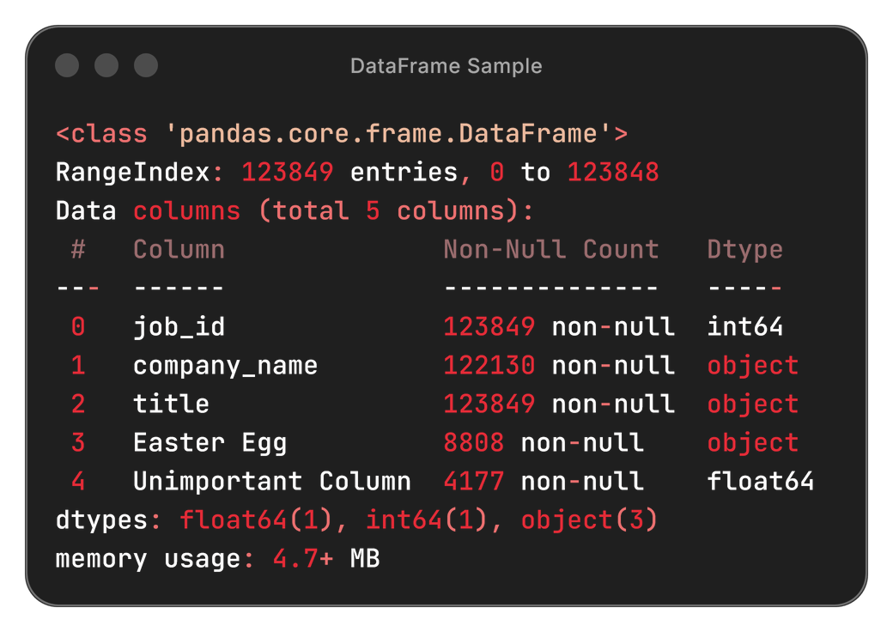
TASK OVERVIEW
Task Overview
Job postings data is often messy and inconsistent, requiring careful preparation before meaningful analysis.
Key issues encountered include:
Missing or incomplete salary information
Inconsistent employment type formatting
Ambiguous remote work indicators
Duplicate or mismatched job IDs across datasets
These challenges highlight the need for structured data cleaning and preprocessing to ensure reliable insights.
Main Tasks Performed
Clean and preprocess all five datasets to standardize formats and handle missing values
Extract and engineer features, removing irrelevant or repeated variables
Merge datasets using common identifiers to build a unified and analyzable structure
Visualize key salary patterns across employment types and remote work arrangements
Interpret findings to directly address the research question
Tools Used: NumPy · Pandas · Matplotlib

Slide 3


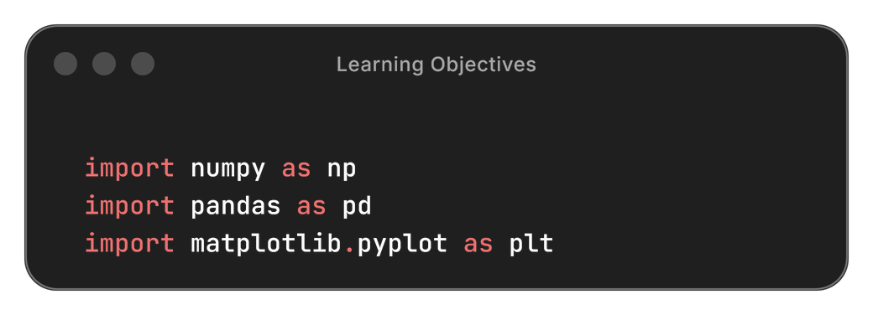
Research Question:
“How do salary offerings vary by employment type and remote work arrangement?”
This analysis investigates:
Whether certain employment types receive higher salaries
How salary levels differ across on-site, hybrid, and fully remote roles
Patterns and distribution shifts in salary based on work arrangement
Learning Objectives
Understand the structure and issues within the datasets
Apply data cleaning to handle inconsistencies and missing values
Perform data preprocessing and simple feature engineering
Merge multiple datasets into a unified DataFrame
Create effective Matplotlib visualisations to explore salary trends
Draw meaningful insights to answer the research question
These objectives directly support the analysis needed to answer the research question.

Slide 4

WORKFLOW OVERVIEW
Load Data
Load & Explore Datasets
Import the five job posting datasets, inspect structure, identify key columns, and check for inconsistencies.
Select Key Features
Focus on salary data, employment type, remote ratio, job titles, and identifiers required for merging.
Merge Datasets
Combine data using job_id to build a unified DataFrame for consistent analysis.
Clean & Preprocess Data
Handle missing values, correct inconsistent categories, engineer simple features, and remove duplicates.
Visualize Salary Patterns
Use Matplotlib to create bar, box, histogram, scatter, and pie/line charts that reveal salary trends.
Analyse & Conclude
Interpret patterns and draw insights to answer the research question.
Select Key Features
Merge Datasets
Clean + Preprocess Data
Visualize Patterns
Analysis + Conclusion

Slide 5

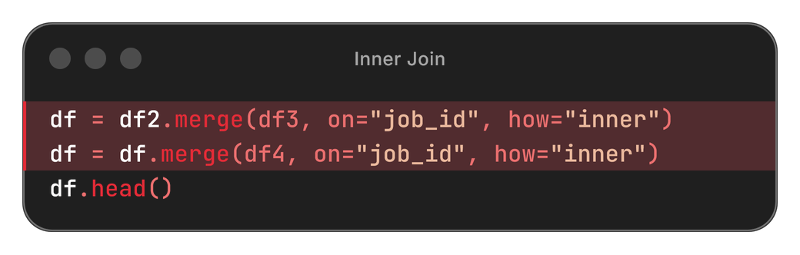

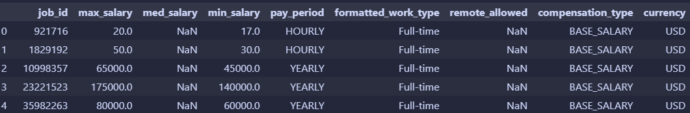
LOADING & EXPLORING DATASETS
Loading & Exploring Datasets
I began by examining all five provided datasets to understand their structure, consistency, and usefulness for answering the research question.
I used:
df.info() → to check data types, null values, and column completeness
df.describe() → to understand numeric distributions (salary, etc.)
df.head() → to view sample rows and sample data
Key Insights
Only datasets 2, 3, and 4 contained relevant fields such as med_salary, work_type, and remote_allowed.
Datasets 1 and 5 did not contain relevant salary or employment-related fields, so they were excluded.
All relevant datasets shared the same key, job_id, making them suitable for merging.
Hence, I combined datasets 2, 3, and 4 using an inner join on job_id to create a unified dataframe. for future analysis.
merge with inner join
postings4.csv

Slide 6
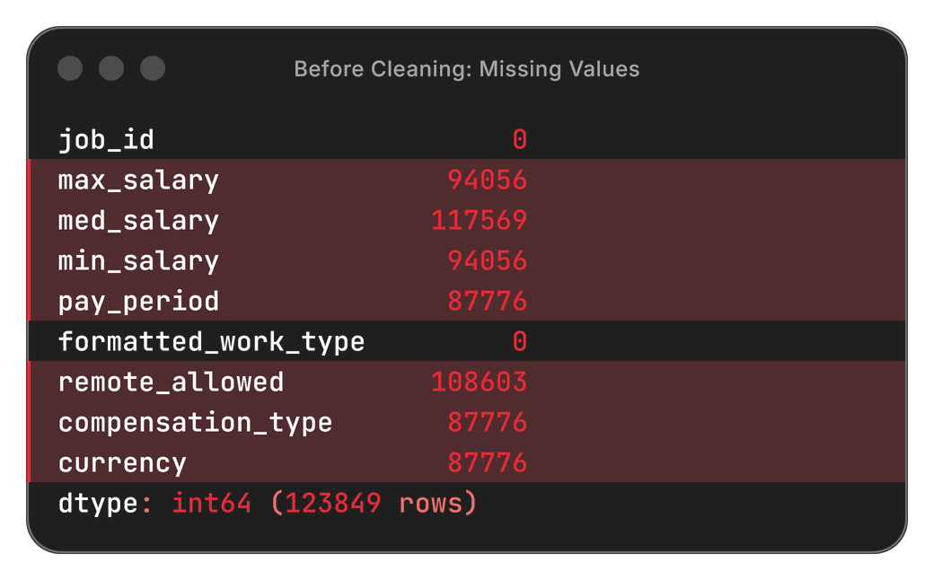

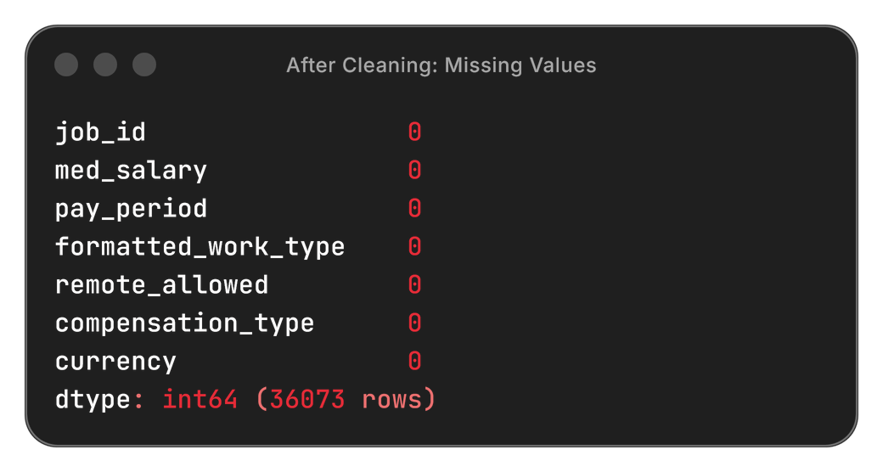
DATA CLEANING
Missing Value Strategy
Goal: Keep useful salary data without adding fake/imputed values.
Salary Columns (max_salary, med_salary, min_salary)
Keep rows with at least one salary value
Avoids imputation
Prevents dropping almost the entire dataset
Most jobs report only one salary field
Categorical Columns (essential grouping features)
Drop rows with missing values
Needed for grouping and comparison
Ensures consistent salary units
Except: remote_allowed (Keep missing values)
Not central to research question
Missing ≠ incorrect — usually “unspecified”
Final Approach
Keep rows with ≥ 1 salary value
Drop rows missing essential categories
Retain missing remote_allowed
Ensures a clean and usable dataset for salary analysis
Reduced dataset from 123,849 → 36,073 rows (≈ 75% removed)

Slide 7
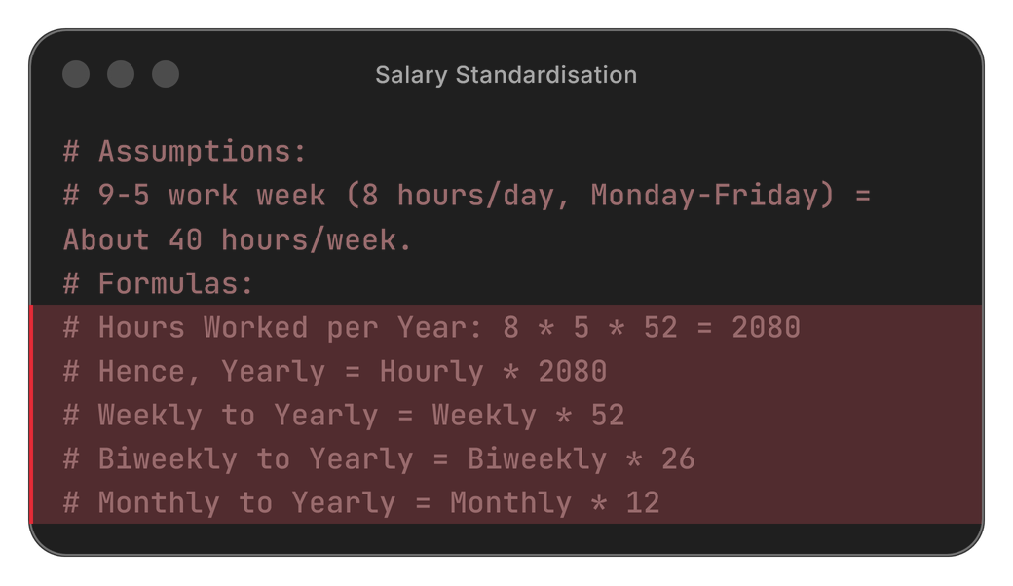
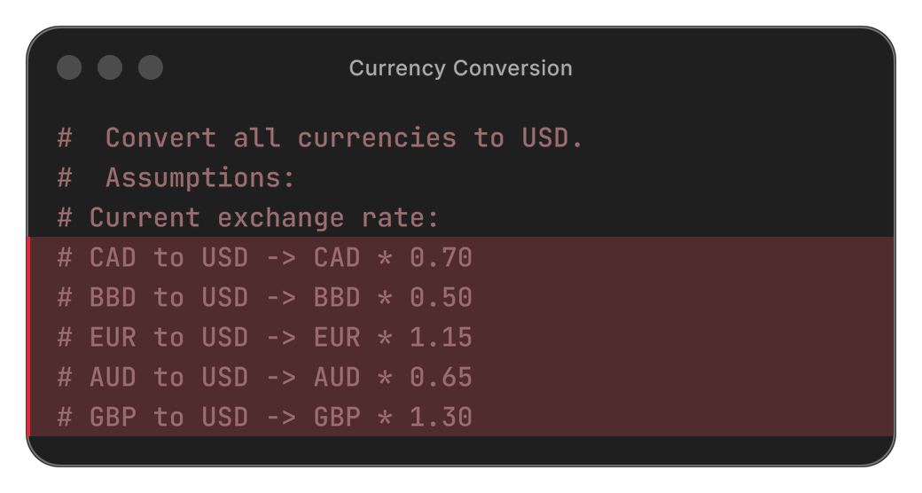
FEATURE ENGINEERING + STANDARDISATION
Feature Engineering
Filled missing med_salary using (min_salary + max_salary) / 2
Ensured every job has a usable median salary value
Salary Standardisation
Converted all salaries to YEARLY by:
Converting pay periods (HOURLY, WEEKLY, BIWEEKLY, MONTHLY) → YEARLY
(Using correct multipliers: 2080 hours/year, 52 weeks/year, etc.)
Ensures salary values are comparable across all job types
Without standardisation, salaries cannot be compared meaningfully.
Currency Conversion
Detected multiple currencies: USD, CAD, BBD, EUR, AUD, GBP
Converted all salaries to USD using appropriate exchange rates
Ensured salaries are in one consistent currency
Standardising to USD removes currency bias when comparing global job postings.
Standardising pay periods and currencies ensures all jobs can be compared fairly and accurately.

Slide 8
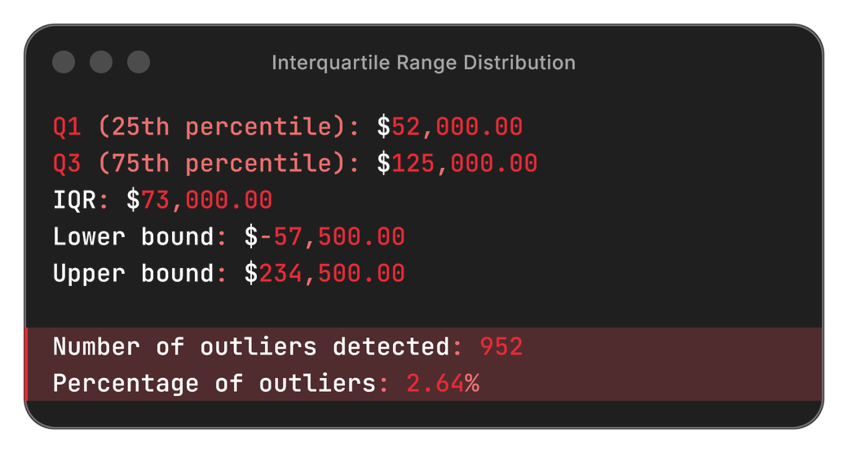
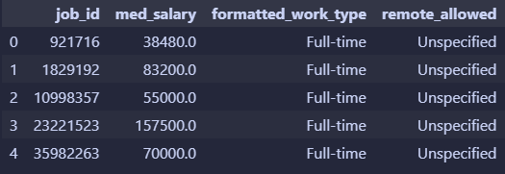
STANDARDISATION + OUTLIERS
Categorical Standardisation
formatted_work_type
Already consistent (Full-time, Part-time, Contract, Internship, Volunteer, etc.)
No transformation required
remote_allowed
1.0 → converted to "Remote"
Missing values → kept as "Unspecified"
Outlier Detection
Identified extreme salary values using IQR method
Chose not to remove outliers, as they represent real and meaningful salary variation.
Final Feature Selection
Kept only the features relevant to the research question:
job_id
med_salary (yearly)
formatted_work_type
remote_allowed
This creates a focused dataset aligned directly with the research question.
final dataset (preview)

Slide 9
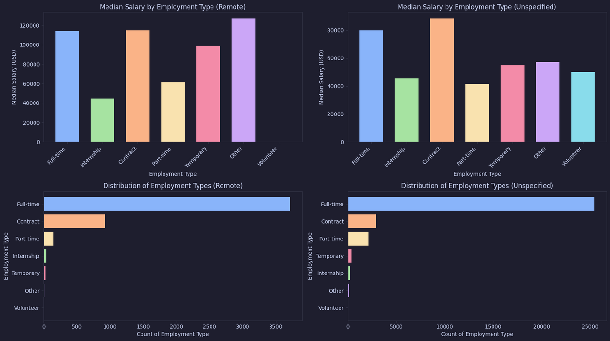
SALARY DISTRIBUTION BY REMOTE WORK STATUS
Key Insights
Remote roles generally pay higher, especially Full-time and Contract
Salary ranking stays the same:
Contract > Full-time > Temporary > Internship > Part-time
Unspecified roles show similar patterns, but usually slightly lower
Notable Observations
“Other” (Remote) shows very high salaries — likely specialized roles
Remote Volunteer salaries are unreliable due to tiny sample size
Interpretation
Higher remote salaries may reflect:
global talent competition
skill premiums for remote-ready roles
Limitations
Some categories (e.g., Remote Volunteer, Remote Temporary) have very few observations, so results should be interpreted cautiously

Slide 10
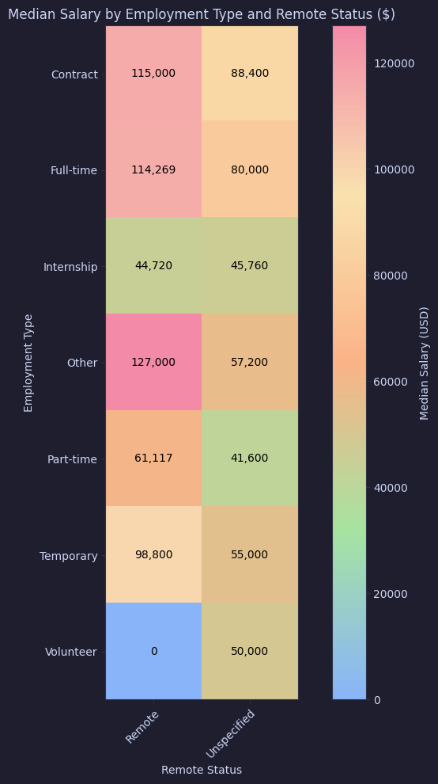

HEATMAP: EMPLOYMENT TYPE X WORK STATUS
Key Visual Patterns
Stronger, warmer colours on the Remote column show that remote roles generally offer higher salaries
Contract and Full-time rows stand out with the highest intensity, especially on the Remote side
Internship and Part-time rows remain in cooler tones, indicating consistently lower salaries
What the Heatmap Highlights
Makes salary gaps immediately visible through colour contrast
Shows both dimensions (work type + remote status) at once
Reveals clear salary jumps — e.g., Remote Full-time vs Unspecified Full-time
Notable Observations
“Other” (Remote) shows the brightest cell (highest median)
Volunteer (Unspecified) shows $50k, likely due to a very small sample size.
Limitations
Only 2 categories: Remote and Unspecified
Some rows are affected by small sample sizes

Slide 11
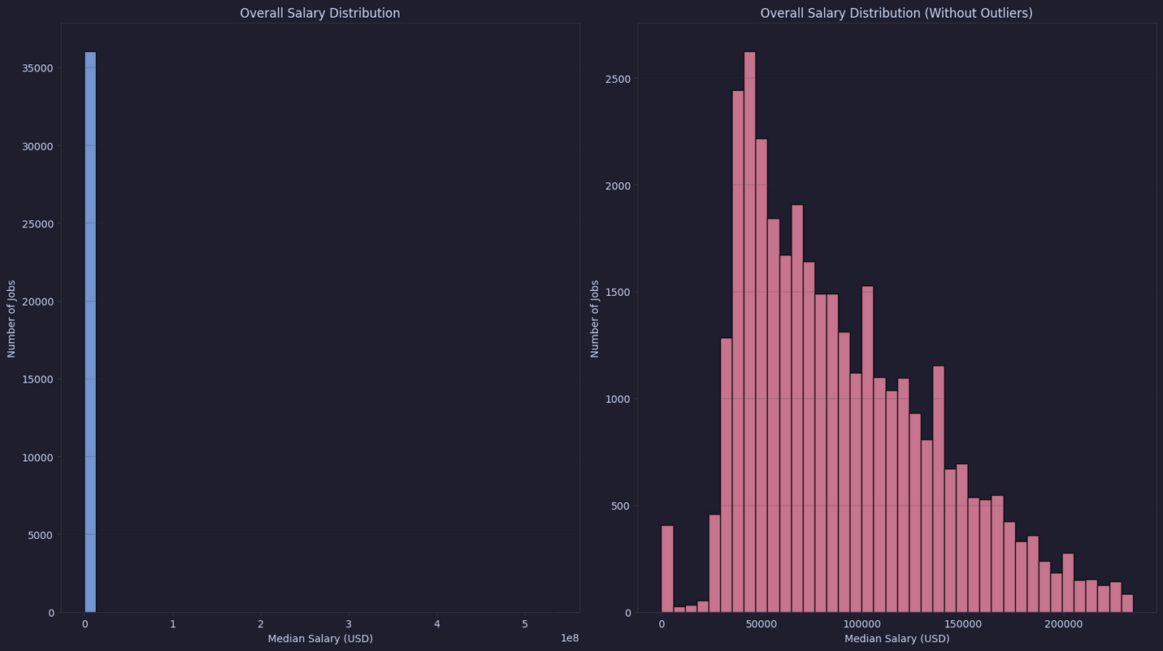
MEDIAN SALARY DISTRIBUTION
Key Patterns
Full dataset is strongly right-skewed due to extremely high salaries.
Most jobs lie between $40k–$125k, but this is hidden before filtering.
After removing outliers, the distribution becomes much clearer and more realistic.
What the Histograms Reveal
Outliers stretch the axis, compressing the true distribution on the left.
Filtered view shows a clear peak around $50k–$100k, representing typical salaries.
Removing outliers improves visibility while keeping the overall shape.
Interpretation
Salary data naturally skews right — a few roles pay far more than the rest.
Outliers matter for context but can distort general salary comparisons.
Limitations
IQR may remove a few high-salary roles, but they are very rare and do not change the overall salary pattern.

Slide 12
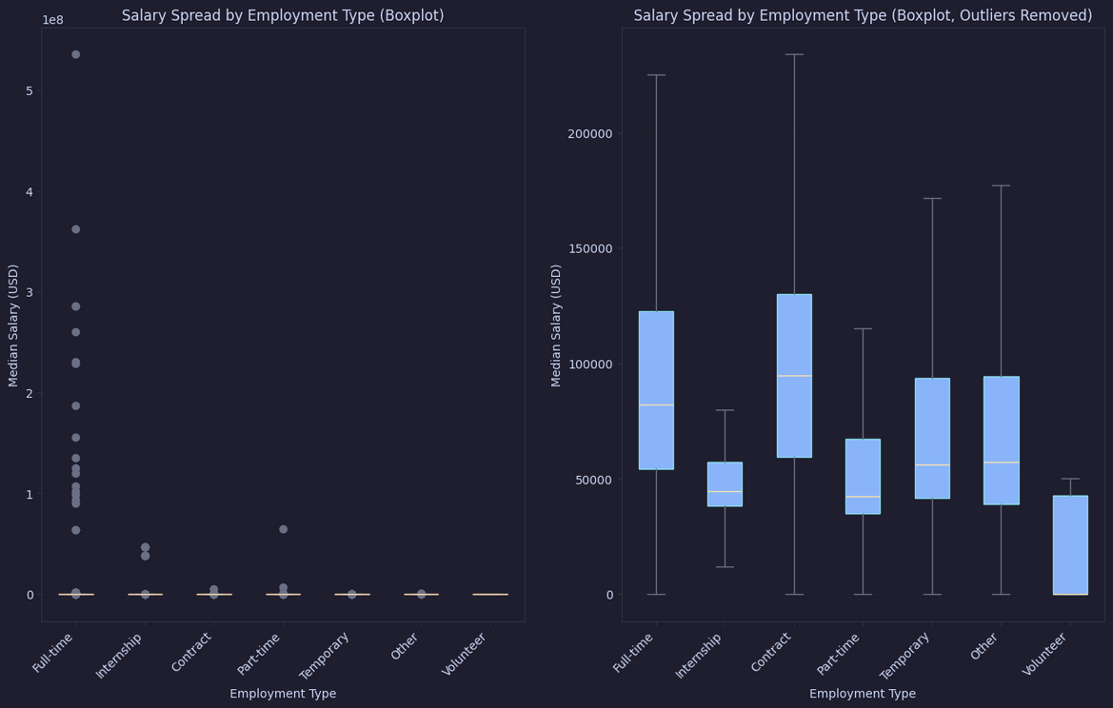
SALARY SPREAD BY EMPLOYMENT TYPE
Key Insights
Full-time and Contract roles have the highest medians and widest spread.
Part-time, Temporary, and Internship roles show lower, tighter ranges.
Volunteer roles correctly show a median of $0.
Outliers in the first plot inflate salary ranges, especially for Full-time and Contract.
After removing outliers, salary patterns become clearer and easier to compare across job types.
Interpretation
Salary variability reflects the nature of each job type — flexible roles (Full-time/Contract) naturally have wider pay ranges.
Removing outliers reveals realistic salary expectations for most workers while preserving the overall trends.
Limitations
Some categories still have small sample sizes (e.g., Volunteer), which limits comparison accuracy.
Outlier removal may hide legitimate high-earning roles, especially in specialized industries.

Slide 13
CONCLUSION
“How do salary offerings vary by employment type and remote work arrangement?”
Key Takeaways
• Contract & Full-time roles offer the highest salaries
• Remote roles consistently pay more than Unspecified roles
• Salary ranking stays stable → Contract > Full-time > Temporary > Other > Internship > Part-time > Volunteer
• Most salaries fall within $40k–$125k, before extreme outliers stretch the distribution
• Removing outliers reveals clearer, typical salary patterns
Limitations
• “Unspecified” remote status mixes on-site, hybrid, and unknown
• Small categories (Volunteer, Other) skew medians
• Posted salary may differ from actual compensation
Overall Conclusion
Salaries vary significantly by both employment type and remote status. Contract and Full-time positions offer the highest earnings, while lower-commitment roles pay less. Remote roles consistently pay more than unspecified ones, with Remote Contract and Remote Full-time jobs showing the strongest financial advantage.

